Slide 1
Rest on aws
Jhulfikar Ali Ahamed Kabeer
Date: 26 Feb 2017

Slide 2
Agenda
Objective - Running rest application in AWS (Language: Java)
Introduction to Rest services
Small Introduction to Microservices
Small Introduction to Docker and Containerization
Deploying the sample Rest Application to AWS
Continuous Learning

Slide 3
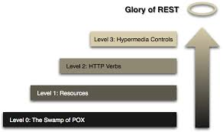
Richardson maturity model

Slide 4
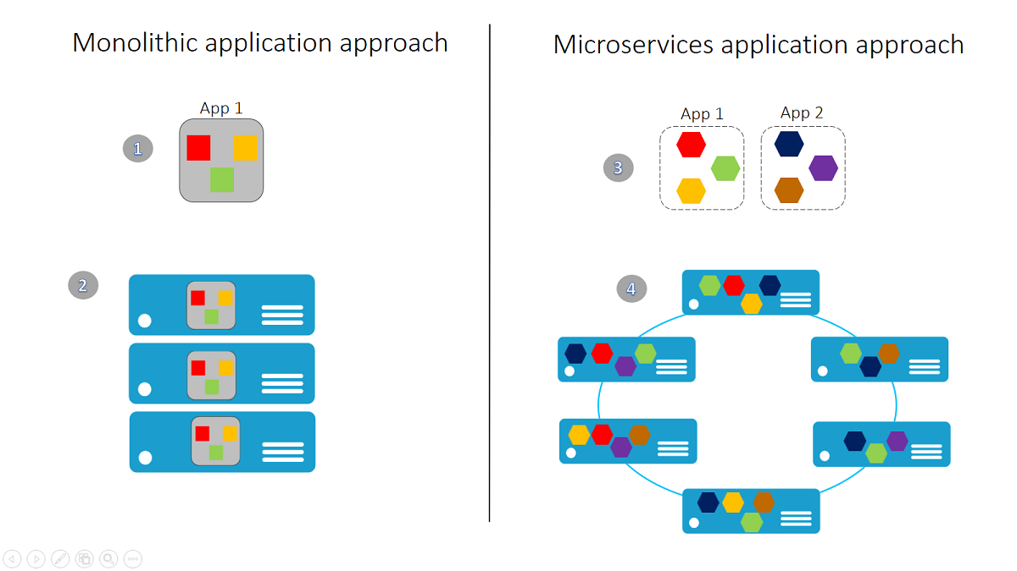
Microservices

Slide 5
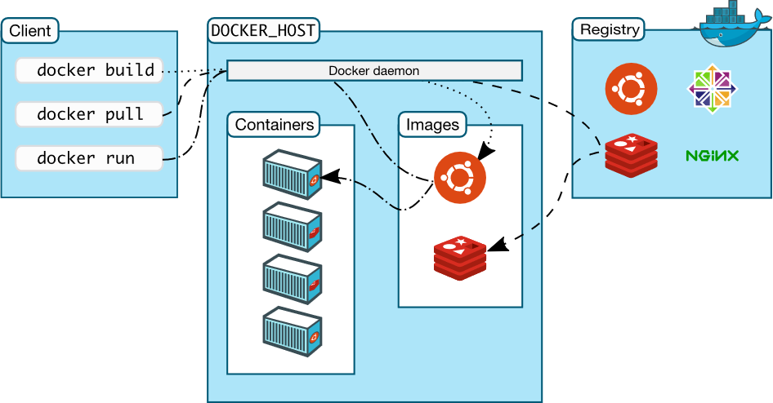
docker

Slide 6
Steps for sample app deployment
Deploy hello world
Search for logs
Running the application
Time for next course (Suggestions needed)

Slide 7
Questions/feedback

